Slide 1
at Te Poi School
Mary Jamieson
www.tetoitupu.org

Slide 2
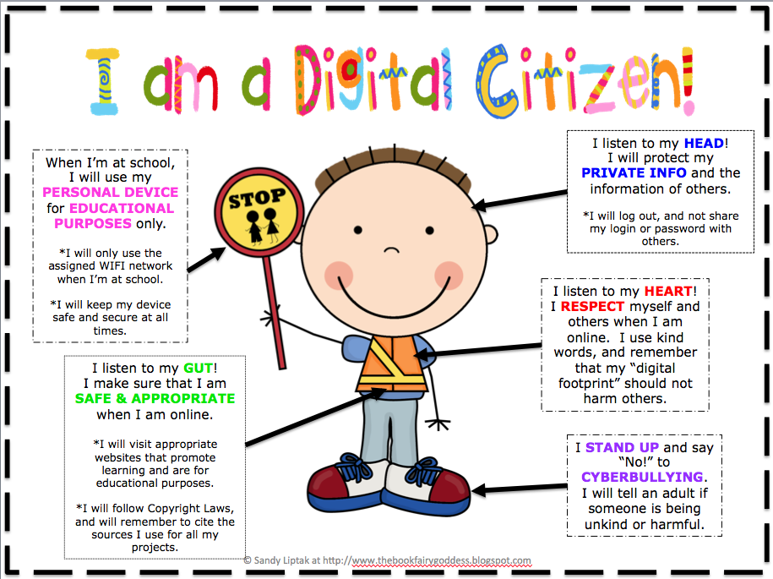
What is Digital Citizenship?
Digital Literacy
Media Literacy
Cybersafety
Information Literacy
Notes:
Digital Citizenship is made up of various elements. Digital Literacy is the overarching term for an individual’s ability to find, evaluate, use and create information using the internet. Media Literacy is the ability to understand the complex messages we receive through different types of media, e.g. newspapers, video, tv, radio, the internet, video games etc. Cybersafety- keeping safe in online environments. Information Literacy is about knowing information is needed and being able to access it, evaluate it and use it effectively.

Slide 4
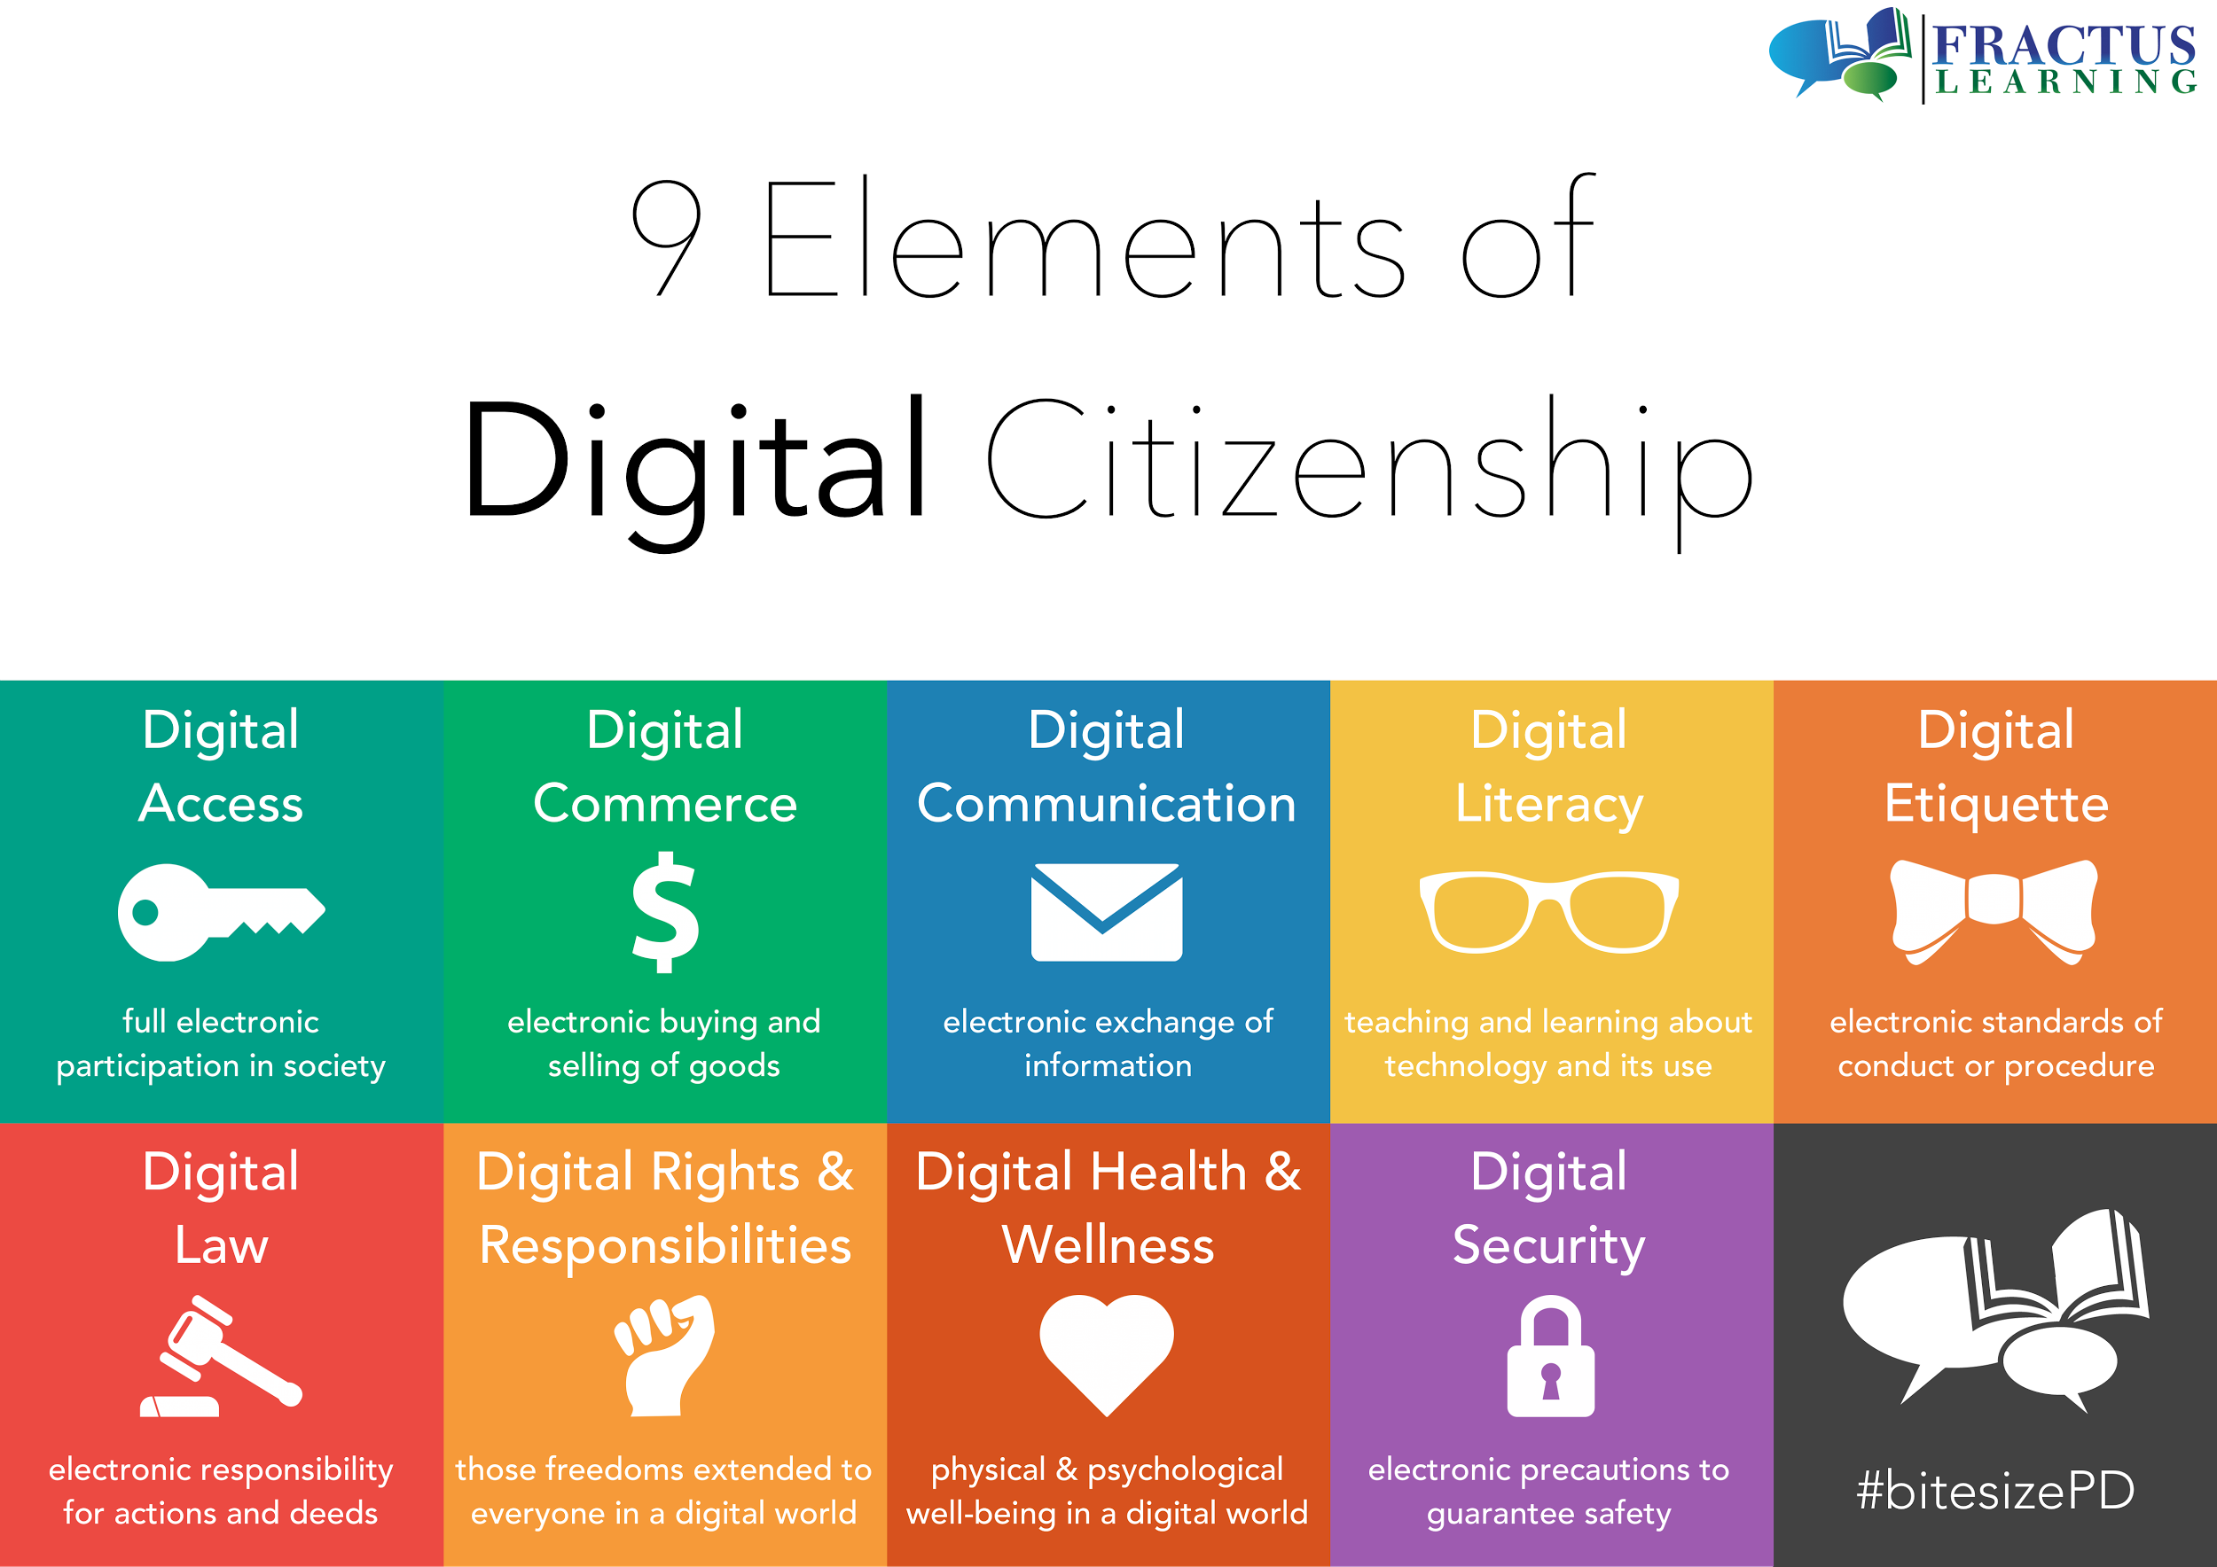
Notes:
This slide show what we aspire to achieve for our young people. As adults we have had a rather hit and miss journey of understanding but our young people are surrounded by this digital world. At a primary school level we need to simplify what we want to achieve. The Learn, Guide, Protect mantra from Netsafe is what we use to decide how this will look at the different levels of schooling.

Slide 5
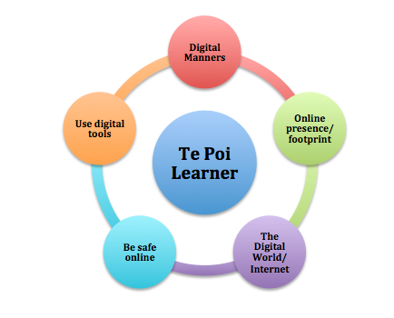
Notes:
At a primary level these 5 elements are the most important.

Slide 6
Digital Dossier
Digitally dodgier

Slide 7
Too Much Information

Slide 8
Learn Guide Protect
Netsafe Kit for Schools- our guiding framework
Notes:
Netsafe is the resource that many schools in New Zealand use to guide the development of digital citizenship programmes.

Slide 9
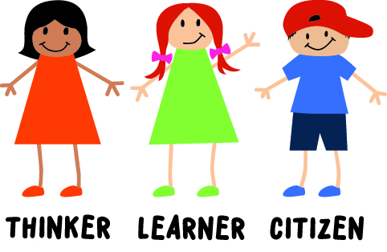
What’s happening at school?
Adding the digital factor to our 3 characters
Policy
N4L filtering system
Class Programmes
Your survey feedback

Slide 11
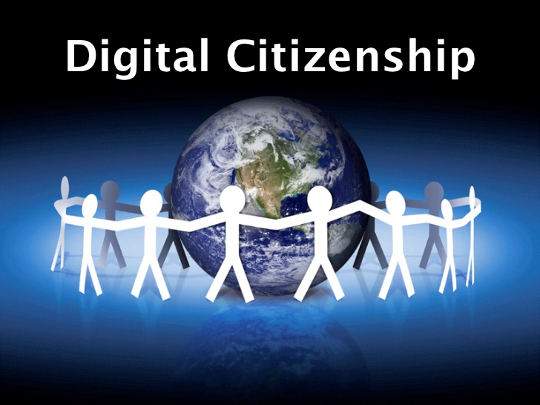
What can I do as a parent?

Slide 13
What about us?
How many websites are you registered with?
How much personal information have you shared?
Think about online competitions you have entered? Facebook? Ezibuy? Trademe? Grabone? etc
How can you model “good digital citizenship” practices for your child?
Notes:
Think about the ways in which you sue the internet. Who shops online? Who pays bills online? Who banks online? Who emails? Who uses Facebook? Trademe? As adults we are in a prime position to role model good digital citizernship practices for our children. When we register for online sites, do we fill in all the information requested? Do we use our real name? Do we always need to? Do we keep track of all the accounts and passwords we use? What safeguards do we put in place for ourselves?

Slide 14
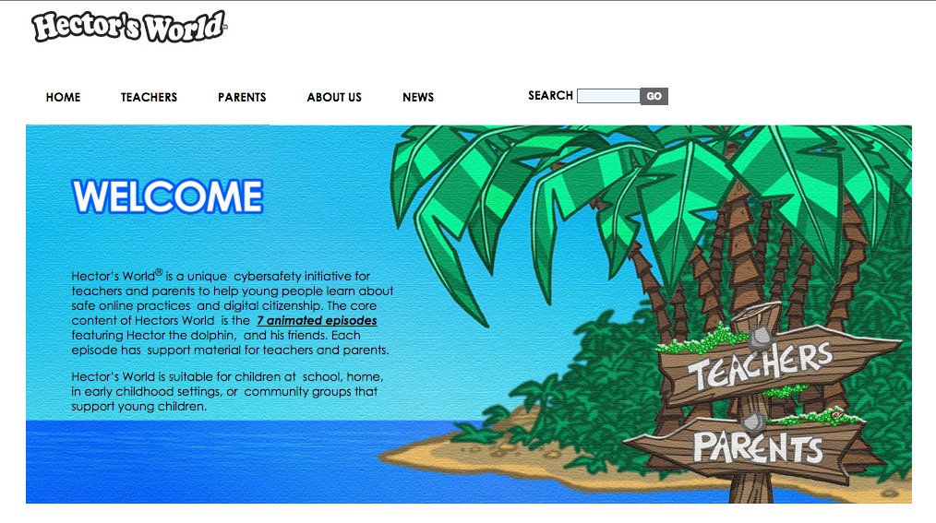
Hector’s World
http://hectorsworld.netsafe.org.nz/

Slide 15
Netbasics Website
Netbasics
http://www.netbasics.org.nz/

Slide 16
Common Sense Media

Slide 17
Notes:
On average, 99% of the respondents to our survey said their children spent up to 2 hours a day online. What are they doing?

Slide 18
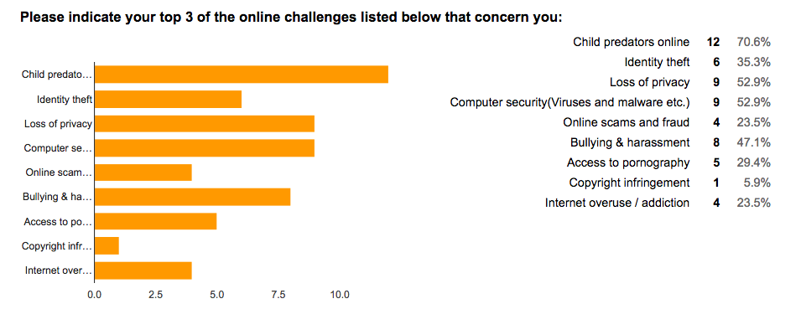
Notes:
Child predators, loss of privacy, computer security, and bullying are key concerns this community has. Knowing this will inform the way in which the school programmes help students learn about the dangers of the internet, guide them with ways to deal with events, and protect them where necessary.

Slide 19
Notes:
80% of people said they had 2 or more smartphones in the home. These are basically a mini computer. When students are out of the school grounds, they need to know how to be cybersmart.

Slide 20
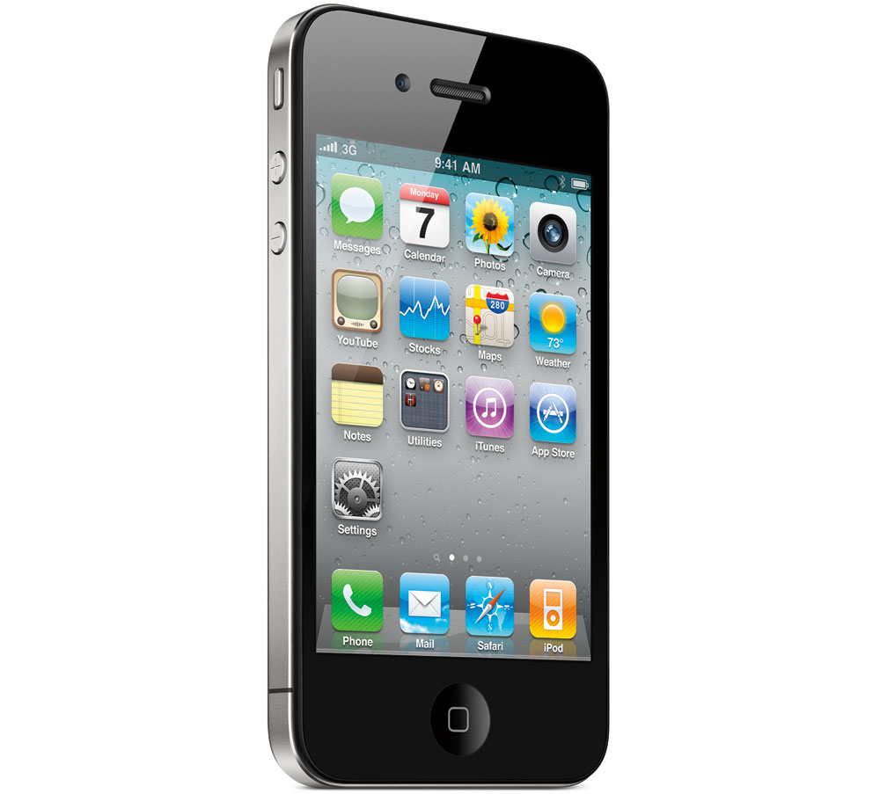
Talk to your child
Sit with them/talk with them when they are online
Consider monitoring screen time
Use opportunities for learning

Slide 21
Surfing the Net
Hector’s World Safety Button
Google Chrome- turn on Safe Search-adjust your search filters

Slide 22
Contact:
Name: Mary Jamieson
Job Title: Facilitator Learning with Digital Technologies
Email: maryjam@waikato.ac.nz
www.tetoitupu.org

